Slide 1
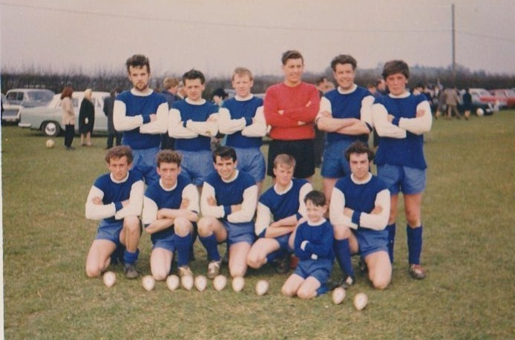
Ivor Braggin Ian Searl Geoff Johnson Gerry Bayliss Norman Blencowe Robert Coleman
Brian Jeffries Alan Coleman Paul Messer Dave Edmunds Graham Smith
Philip Jeffries

